Slide 1
Analysis on Why Women and Children are Vulnerable for Human Trafficking in India Year 2019
________________________________
Team Record Keepers
Jeoma Raye Alejandrino Almazan • Mary Joy Lasco
Rico Littawa • Xielo Jeff Manalo • Marnel Javier Valentin

Slide 2
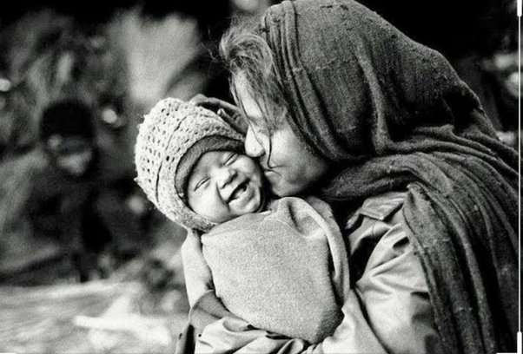


Slide 3


OBJECTIVE
To raise awareness that many people have been manipulated to do wrongdoings or have been abused because of human trafficking.
To make recommendations for preventing human trafficking in India.
To analyze the victims that have been trafficked, gender, age/group, purpose of the trafficking, rescued victim, and number of culprits arrested/acquitted in the year 2019.
SDG #1
No Poverty
SDG #16
Peace, Justice and Strong Institutions

Slide 4
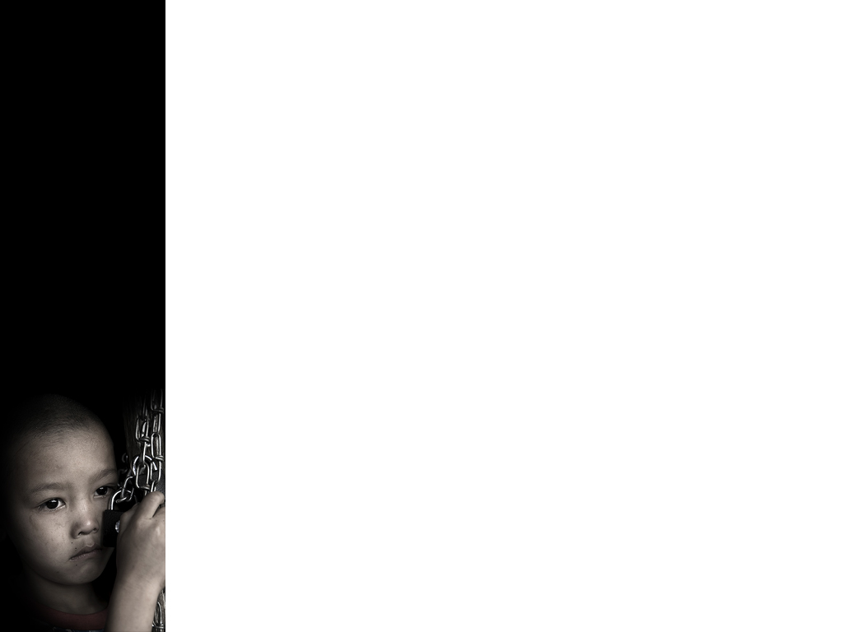
PROBLEM
Why Women and Children are Vulnerable for Human Trafficking in India Year 2019

